Slide 1

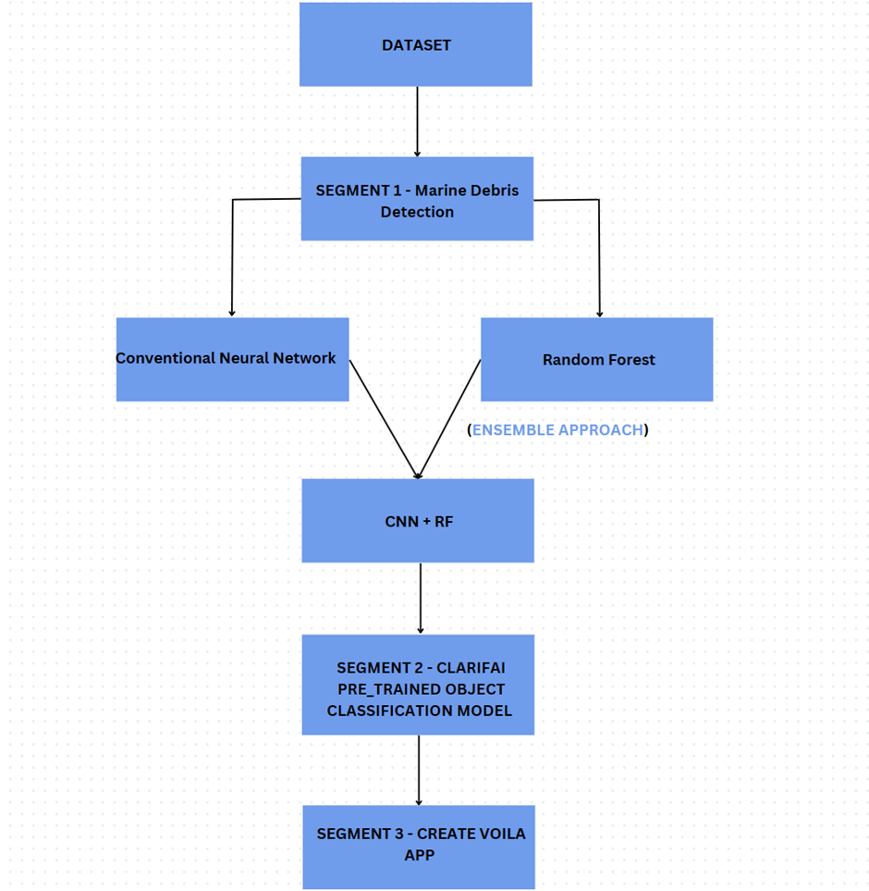
AALIM MUHAMMED SALEGH COLLEGE OF ENGINEERING
DEPARTMENT OF COMPUTER SCIENCE AND ENGINEERING
ADVANCED MARINE DEBRIS DETECTION SYSTEM
ABSTRACT
INTRODUCTION
EXISTING SYSTEM
PROPOSED SYSTEM
Plastic pollution in oceans threatens marine life and ecosystems globally. Traditional detection methods are costly and labor-intensive. We propose a scalable solution using deep learning techniques, including convolutional neural networks (CNNs) and ensemble learning, to enhance detection accuracy.
Our study compares individual models like Simple CNN and Random Forest with an ensemble approach, achieving perfect accuracy and an F1 score of 1.0. We also integrate the Clarifai API for object detection, offering a user-friendly Voila app for real-time detection.
This research contributes to environmental awareness and provides a sustainable solution to combat plastic pollution.
PROJECT GUIDE
Dr.E.GANESH HOD,CSE
PROJECT TEAM
ABDUL HAFEEL H A - 110120104025
MOHAMED JAASIR A - 110120104025
MOHAMED MUBEEN A - 110120104028
MOHAMED NAFEES F - 110120104029
Plastic pollution in our oceans has become a critical environmental concern, posing severe threats to marine life, ecosystems, and human health. With over 500 million tonnes of plastic produced globally, approximately 30% of it ends up in our oceans. Quantifying and mapping marine plastic debris is crucial for understanding its impact and implementing effective mitigation strategies. However, traditional methods of monitoring marine debris, such as physically collecting samples using manta trawls, are costly, time-consuming, and labor-intensive. Hence, there is an urgent need for scalable, real-time solutions to monitor plastic pollution across Earth’s oceans.
In response to this challenge, we propose a novel approach leveraging deep learning techniques for marine debris detection. In this project, we aim to develop accurate and efficient models for detecting marine debris in oceanic environments. By harnessing the power of cutting-edge convolutional neural networks (CNNs) and ensemble learning methods, we seek to provide a scalable and cost-effective solution for monitoring plastic pollution in our oceans.
Duarte and Azevedo's innovative approach centers on the utilization of Sentinel-2 satellite imagery for the detection of plastic marine debris, showcasing an impressive accuracy rate of 98%. While this method holds considerable promise in enhancing our ability to identify and monitor such environmental hazards, it does come with a set of inherent limitations. Notably, the reliance on ground-truth validation poses a significant challenge, as this process can often be both time-consuming and resource-intensive.
Moreover, the system encounters complexities when attempting to detect debris characterized by mixed bands, leading to potential inaccuracies in identification. Furthermore, the task of accurately discerning debris within pixels proves challenging due to the subpixel coverage issue, further complicating the detection process. Such advancements hold the potential to significantly enhance our understanding of plastic pollution dynamics in marine environments and facilitate more effective mitigation strategies in the future.
The proposed system aims to transform marine debris monitoring by leveraging advanced deep learning techniques and computer vision. Key features include developing CNN models tailored for accurate marine debris detection, exploring ensemble learning for improved accuracy, assessing model performance with metrics like precision and recall, implementing algorithms for estimating marine debris percentage in ocean images, utilizing Clarifai API for precise object detection, and creating a user-friendly interface with Voila for easy image upload and real-time detection results.
This system eliminates costly manual data collection, offers timely detection and intervention, is deployable across large areas for comprehensive monitoring, ensures precise marine debris identification, provides insights into plastic pollution extent, and simplifies usage with an intuitive graphical interface for stakeholders.
CONCLUSIONS
METHODOLGY
SYSTEM FLOW DIAGRAM
Our research introduces a novel marine debris detection system using deep learning and computer vision techniques. Leveraging CNNs, random forest classifiers, and ensemble learning, our system accurately identifies and categorizes marine debris in oceanic images. Through rigorous testing, we've demonstrated high precision and recall. Integration of the Clarifai API enables real-time object detection, while a user-friendly Voila app enhances accessibility. Our system offers a reliable tool for plastic pollution monitoring, supporting environmental conservation efforts and advocating for long-term solutions to preserve marine ecosystems.
Deep learning, a subset of machine learning, harnesses artificial neural networks to discern intricate patterns within data, eliminating the need for explicit programming. Convolutional Neural Networks (CNNs), inspired by the visual cortex, excel in image recognition tasks, employing convolutional layers, pooling layers, activation functions, and fully connected layers. Training involves backpropagation, optimizing weights and biases to minimize a loss function. Random Forest (RF), an ensemble method, constructs numerous decision trees, each trained on random data subsets, mitigating overfitting through random feature selection and bootstrap aggregation. RF's voting mechanism aggregates decision trees' outputs for robust predictions. Combining CNN's feature extraction prowess with RF's decision-making, the CNN + RF ensemble approach achieves heightened accuracy. Additionally, leveraging Clarifai API facilitates streamlined object detection tasks, enabling seamless integration into environmental monitoring systems.
BATCH NO : 1
REFERENCES
Marin, I., Mladenović, S., Gotovac, S., & Zaharija, G. (2021). Deep-feature-based approach to marine debris classification. Applied Sciences, 11(12), 5644.
Aleem, A., Tehsin, S., Kausar, S., & Jameel, A. (2022). Target Classification of Marine Debris Using Deep Learning. Intelligent Automation & Soft Computing, 32(1).
.

